Slide 1

SBA1101
PRINCIPLES OF MANAGEMENT AND PROFESSIONAL ETHICS
Dr. N. M. Nandhitha / Dr. S. Emalda Roslin
Associate Professor,
School of Electrical and Electronics
Sathyabama Institute of Science and Technology
Cehnnai

Slide 2
PERSONALITY
‘Physical’ and ‘Psychological’ characteristics of a person
‘The sum total of ways in which an individual reacts and interacts with people and situations’
‘Personality is an individuals reactions to situation and people as per his/her reaction’
Heredity
Biological factors which are determined at the stage of creation of an individual (i.e. at birth). This transfer of qualities from parents to their children are termed as “heredity”
    Biological factors
      like gender, blood typing, color of eyes, intelligence, health related diseases, such as color blindness, baldness, diabetes etc)
    Physiological factors
      like muscles, skin texture, sensitivity of skin etc
    Psychological factors
like anger, emotions, temperament, etc
Environment
The surroundings in which an individual is born and brought up influences the personality (culture, religion, language, family background, social customs)
Situation
The different demands on an individuals different based on the situation. This changes the personality

Slide 3
PERSONALITY THEORIES
I. Type Theories
    Introvert
    Extrovert
    Judgmental
    Perceptive
    Type A and Type B
Trait Theories
Big 5 Model
III. Psycho – Analytical Theories
    Id
    Ego
    Super Ego
IV. Socio – Psycho Analytical Theory
Self Theory

Slide 4
TYPE THEORIES (KRETSCHMER AND SHELDON)
Based on features of body/face, and Psychological factors
Type theories place personality into clearly identifiable categories.
Relationship was sought to be established between features of face or body and personality.
    Endomorph sociable, relaxed and even tempered
    Ectomorph restrained , self, conscious and fond of solitude
    Mesomorph noisy, and found of physical activity
This classification of personalities on body basis is subjective. Type theories are simple and popular but no substance

Slide 5
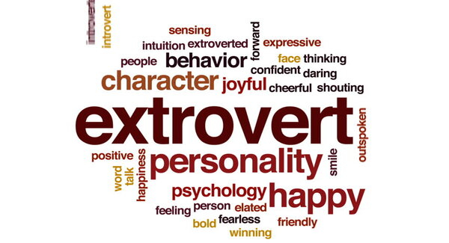

TYPE THEORY (CARL JUNG)
INTROVERT
EXTROVERT
These people are interested in themselves, their opinions, their ideas, thought about themselves. They avoid contact with others. They do not involve in taking to others, they make very bad team mates. They enjoys loneliness. These people are good in thinking and analytical skills.
They are opposite to introverts. They are friendly sociable, lively and express their feelings, ideas openly and freely. They are more suitable and successful for the positions that require talking to others.

Slide 6
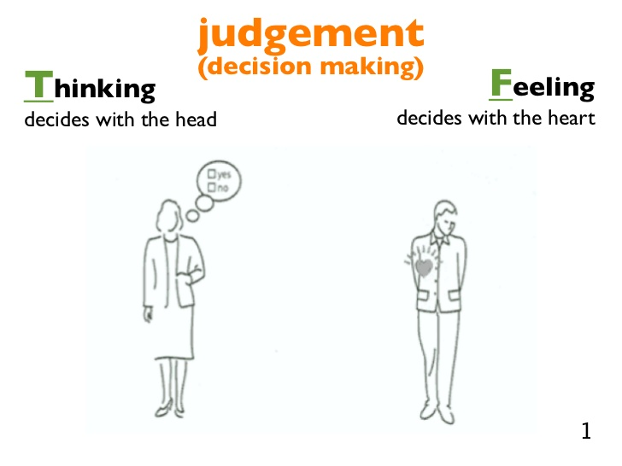
TYPE THEORY (CARL JUNG)
JUDGEMENTAL
PERCEPTIVE TYPES
These people want to know everything. They get over involved. They also adapt well to change
Type A
The Productive and hard working people are classified as Type A. They are workaholics. They are impatient, aggressive, high achievement oriented. These people are prone to stress and health related problems.
Type B
They are easy going, sociable free from time problems, relaxed and are non-competitive. They make a good job as team members however they are not fast.
These people like to follow a plan, make decisions and take only what is essential for their work. Example: Functional Experts

Slide 7
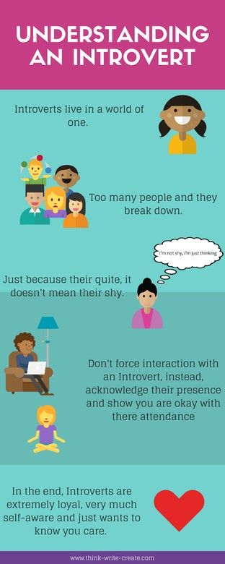

Slide 8
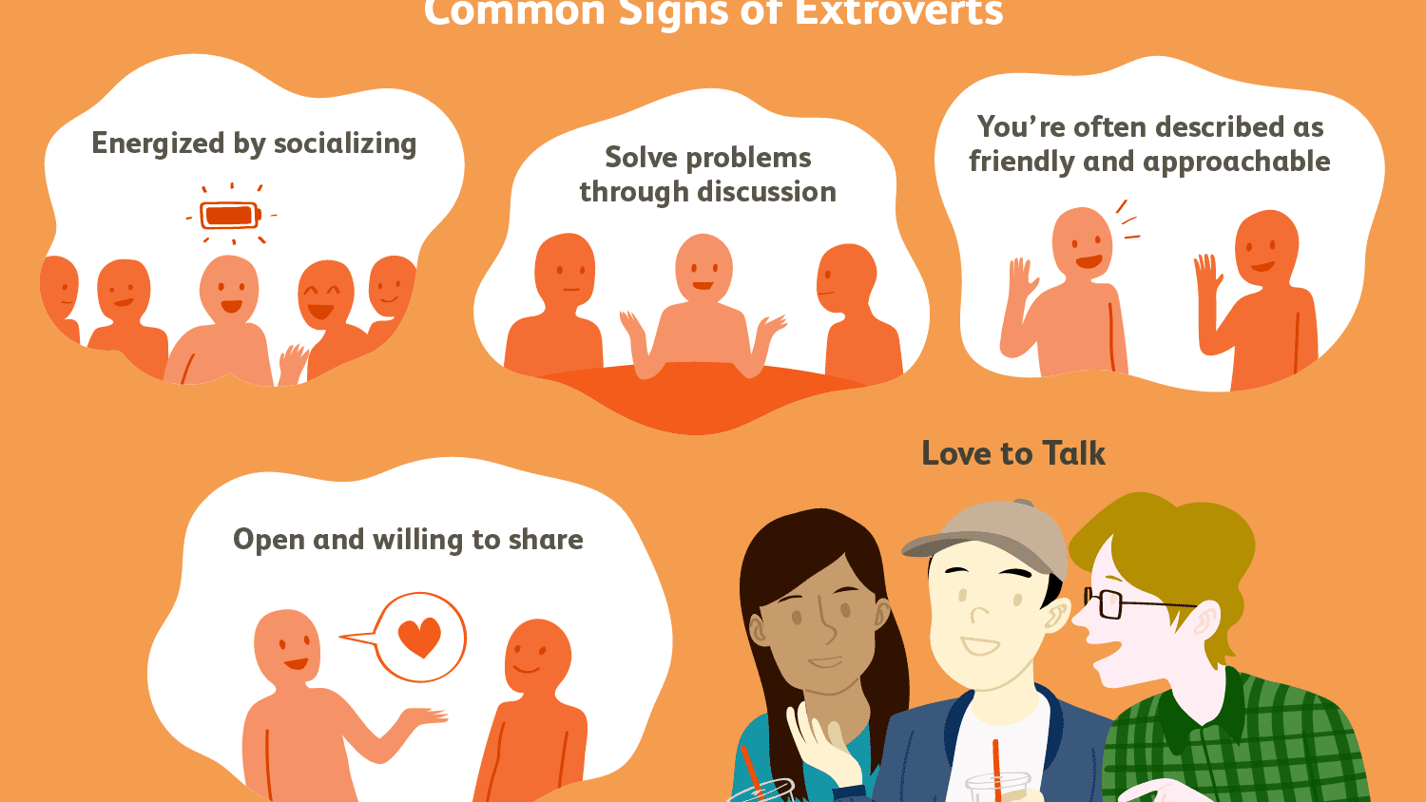

Slide 9


Slide 10
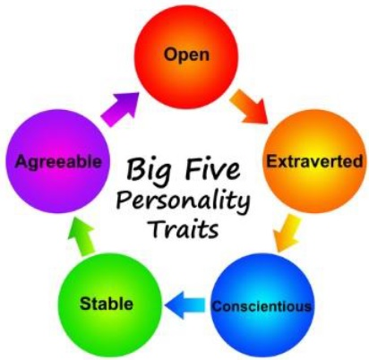
TRAIT THEORY (O.P. JOHN )
Trait is defined as an enduring (long lasting) characteristics of a person by which he or she differs from another.
A trait is abstracted from his/her behavior.
Serves as an useful ‘Unit of analysis’ to understand personality.
Shy, aggressive, submissive, loyal, ambition, timid are some of the common traits of human.
  Traits are common to all individuals but they vary in the amounts or levels between individuals.
  Traits are relatively stable and they cause similar effects on behavior irrespective of the situation.
  Individual traits can be understood by measuring their behavior
Extroversion (sociable, talkative and assertive)
Agreeableness (Good natured, co-operative and trusting)
Conscientious (Responsible, dependable, achievement oriented and persistent with work)
Emotional Stability (Calm, nervous, enthusiastic and insecure)
Openers to experience (Imaginative, artistic, creative and intellectual)

Slide 11
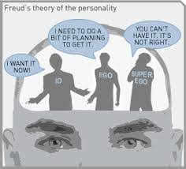
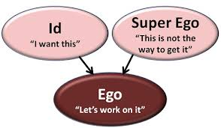
PSYCHO-ANALYTIC THEORY (SIGMUND FREUD)
Based on the in-depth study of individual behavior.
According to Freud, the human minds is composed of 3 elements
      The Preconscious - Super Ego
      The Conscious - Ego
      The unconscious - ID

Slide 12
PSYCHO-ANALYTIC THEORY (SIGMUND FREUD)
ID contains everything inherited present at birth and fixed in the individuals constitution
Unconscious part of mind, Primary principle of all human life
Immediate tension reduction is called the pleasure principle and the ID obeys it, It seeks immediate gratification for the biological needs.
It leads to dangerous decision which harmful to themselves and others.
ID employees “Reflex actions’ and “Primary process” to rid the tension.
Primary process refers to attempts of an individual to form a mental image of the objects that will remove tension
Reflex action responds automatically to sources of irritation there by promptly removing the tension
EGO Conscious part of personality, Mental images do not satisfy needs, Reality must be considered
The ego develops out of the ID because of the necessity for dealing with the real world
The ego is reality oriented part of thinking.
It is largely practical and works in an executive capacity.
Ego is rational and logical.
Ego is the executive part, because it controls the gateway to action.
Most important characteristic of ego is that it has the ability to distinguish between mental images and actual sources of tension release
Ego performs the following tasks
Observing accurately what exists in the outside world (perceiving)
Recording these experiences carefully (remembering)
Modifying the external world in such a way as to satisfy the instinctual wishes (acting).

Slide 13
PSYCHO-ANALYTIC THEORY (SIGMUND FREUD)
Super Ego Represents noblest thoughts, ideas feelings acquired from his parents, teachers, friends, religion, organization and colleagues etc.,
Super ego is the moralistic segment of human personality.
It determines whether the action proposed by “Ego” is right or wrong.
So that the individual acts in accordance with the values and standards of the society.
Freud says that the Ego’s role is to mediate between the ID and Super ego.
A personality becomes disorderly when either the ID or Super ego become dominant.
Psychologist “Dvane Schart” notes that ID is pressing for satisfaction, the ego is trying to delay it and the super ego urges morality above all. Freud’s human being is therefore described as “ basically battle field.”
Freud’s theory is criticized because it is largely unstable, difficult to define and are ambiguous.

Slide 14
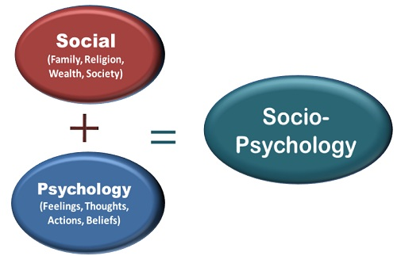
SOCIO – PSYCHO ANALYTICAL THEORY
SELF THEORY (CARLY ROGENS)
Identifies the interdependence of the individual and the society. They rely on each other to achieve their respective goals. From this interaction, the personality of the individuals can be found. This theory is based on two aspects.
Social Variables - Determine and shape individual behavior and personality.
(Biological characteristics are not responsible)
Individuals - Know what they want and their behavior is directed to meet these needs.
Self Image : This is the image of the individual itself. This is how one sees himself. Example : “ I am a good student”. “I am not brilliant like Mr. XYZ”.
Ideal Self : The previous image (self – image ) is reality, this image is imaginary. This is what one calls look like someone else. This image motivates (make) an individual to behave in a particular manner.
Example : ‘ I would like to be called brilliant, extra – ordinary, genius etc”.
Looking Glass Self : (Mirror Image) This image is the image that individuals think as what the others are seeing. It is only an individuals belief of others, but not reality. Example : “People think I am brilliant because I got first rank”.
Real Self : This is what a person actually is. The first 3 images may be the same or different from the real self. The situations around an individual influences these images and behaviors of individuals.

Slide 15

TRANSACTIONAL ANALYSIS
Transactional analysis (TA) is a technique of analyzing and understanding inter-personal behavior
When a person interacts with another a social transaction takes place
In such a transaction one person responds to another
Study of these transactions is what called “Transactional analysis”

Slide 16
TRANSACTIONAL ANALYSIS
IMPORTANT CONCEPTS
Self awareness
Ego states
Transactions
Stroking
SELF AWARENESS
Awareness of self is vital in the context of inter-personal relationships
Behavioral experts have identified four different levels of self awareness
These are:
Open self
Blind self
Hidden self and
Unknown self

Slide 17
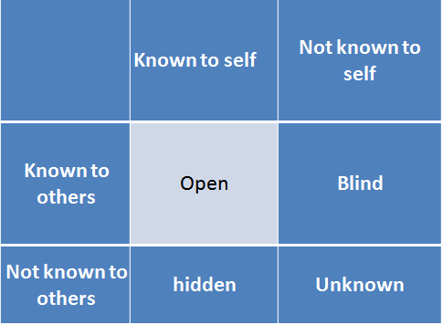
TRANSACTIONAL ANALYSIS
‘open’ self refers to a condition of an individual that is known both to the individual and to the person inter-acting
When the individual is honest and straightforward in his dealings, it should be clear as to what he is doing and what his motives are.

Slide 18
TRANSACTIONAL ANALYSIS
Blind Self
  State of an individual known to others but not known to him
  Example, a person may do certain things unconsciously without knowing the pros and cons of his actions
  But those watching him or inter-acting with him know the consequences of his actions
Hidden self:
  State of an individual known to him but not to others is what is called ‘hidden self’
  Many things a person may not be prepared to discuss with others
Unknown self:
  State of an individual that is neither known to him nor to the people with whom he interacts

Slide 19
TRANSACTIONAL ANALYSIS
LIFE POSITIONS:
Experiences of a person in his interaction with others right from his childhood days lead him to certain conclusions about himself and others.
Referred to as ‘life positions’ that fall into the following four categories:
  1. I am o.k. You are o.k.
  2. I am o.k. You are not o.k.
  3. I am not o.k. You are o.k.
  4. I am not o.k. You are not o.k.

Slide 20
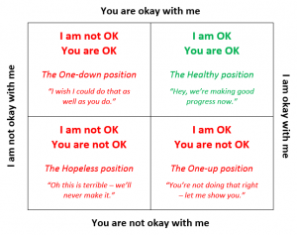
TRANSACTIONAL ANALYSIS

Slide 21
TRANSACTIONAL ANALYSIS
I am o.k. You are o.k.
People taking this life position believe in mutual give and take.
Indulge in activities that are mutually beneficial
Manager acting with this life position delegates the necessary authority to his subordinates to enable them to carry out the task assigned to them
Knows very well that if only the subordinates accomplish their tasks, he will be able to face his superior
I am o.k. You are not o.k.
Person taking this position does not trust others. He has a feeling that he alone can perform i.e., he has superiority complex
Manager acting with this life position does not repose faith in any of his subordinates
Criticizes them often and may not come forward to delegate

Slide 22
TRANSACTIONAL ANALYSIS
I am not o.k. You are o.k.:
Persons who are powerless in comparison to others hold this life position
Understand that they are not in a position to perform as effectively as others
People always complain about others peevishly –take out their frustrations on others
Manager holding the ‘I am not O.K you are O.K’ life position knows very well that his subordinates are better than he is
Such a manager will be keen on finding fault with his subordinates with a view to hiding his own limitations.
I am not O.K. you are not O.K:
Who cannot trust themselves and also others hold this life position
Lack interest in everything
Manager acting with such a life position is poor in everything
Can neither delegate properly nor make good decisions
Such a person can only provoke others

Slide 23

MOTIVATION
Individual behavior directs towards achieving a desired goal or objectives
Engaging in relieving an active tension for fulfilling a desire
A basic principle is that the performance of an individual depends on his or her ability backed by motivation.
Ability refers to skill and competence of the person to complete to given task.
Motivation may be understood as the set of forces that causes people to behave in certain ways.
Motivation is an important factor which encourages persons to give their best performance and help in reaching enterprise goals.
Strong positive motivation will enable the increased output of employees but a negative motivation will reduce their performance.

Slide 24
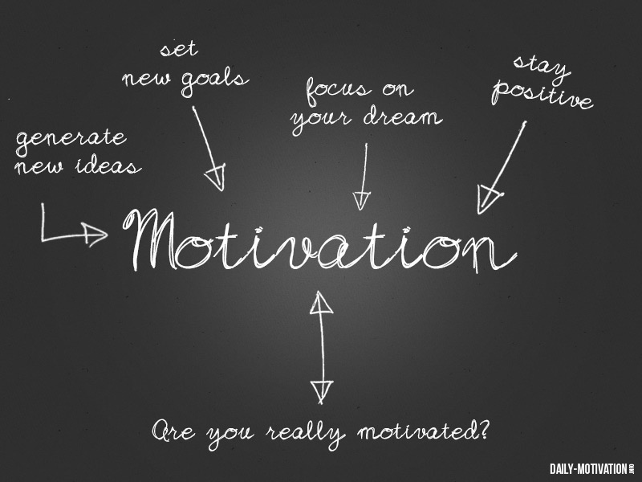
MOTIVATION
Berelson and Steiner:
“A motive is an inner state that energizes, activates, or moves and directs or channels behavior goals.”
Memoria:
“A willingness to expend energy to achieve a goal or reward. It is a force that activates dormant energies and sets in motion the action of the people. It is the function that kindles a burning passion for action among the human beings of an organization.”

Slide 25
MOTIVATION
Motivation requires a need or in other words motives. Thus motive can be classified into:
PRIMARY MOTIVES:-
These motives are essential for an individual survival without these motives his existence would be meaningless. Eg: Drinking water, food, sleep etc.
SECONDARY MOTIVES:-
These are also important for the satisfactory existence of an individual. They may not be as necessary as primary motives. They are required for a happy or comfortable life.
GENERAL MOTIVES:-
These tries to fulfill the achievement needs or self conscious need of individual. Eg: Power, authority, status etc.

Slide 26

NATURE OF MOTIVATION
Motivation is an inner feeling which energizes a person to work more
Emotions or desires of a person prompt him for doing a particular work
Unsatisfied needs of a person which disturb his equilibrium
Person moves to fulfill his unsatisfied needs by conditioning his energies
Dormant energies in a person which are activated by channelizing them into actions

Slide 27
TYPES OF MOTIVATION
When a manager wants to get more work from his subordinates he will have to motivate them for improving their performance.
1. Positive Motivation:
Positive motivation or incentive motivation is based on reward. The workers are offered incentives for achieving the desired goals. The incentives may be in the shape of more pay, promotion, recognition of work, etc. The employees are offered the incentives and try to improve their performance willingly. Positive motivation is achieved by the co-operation of employees and they have a feeling of happiness.
2. Negative Motivation:
Negative or fear motivation is based on force or fear. Fear causes employees to act in a certain way. In case, they do not act accordingly then they may be punished with demotions or lay-offs. The fear acts as a push mechanism. The employees do not willingly co-operate, rather they want to avoid the punishment. Though employees work up-to a level where punishment is avoided but this type of motivation causes anger and frustration. This type of motivation generally becomes a cause of industrial unrest.

Slide 28
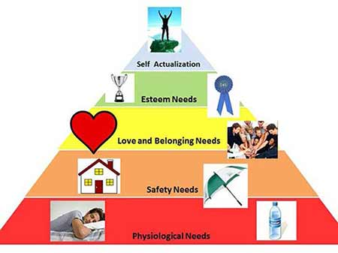
MASLOW’S NEED HIERARCHY THEORY
Abraham Maslow’s motivation theory is based on the human needs
These needs are classified into a sequential hierarchy from the lower to higher order

Slide 29
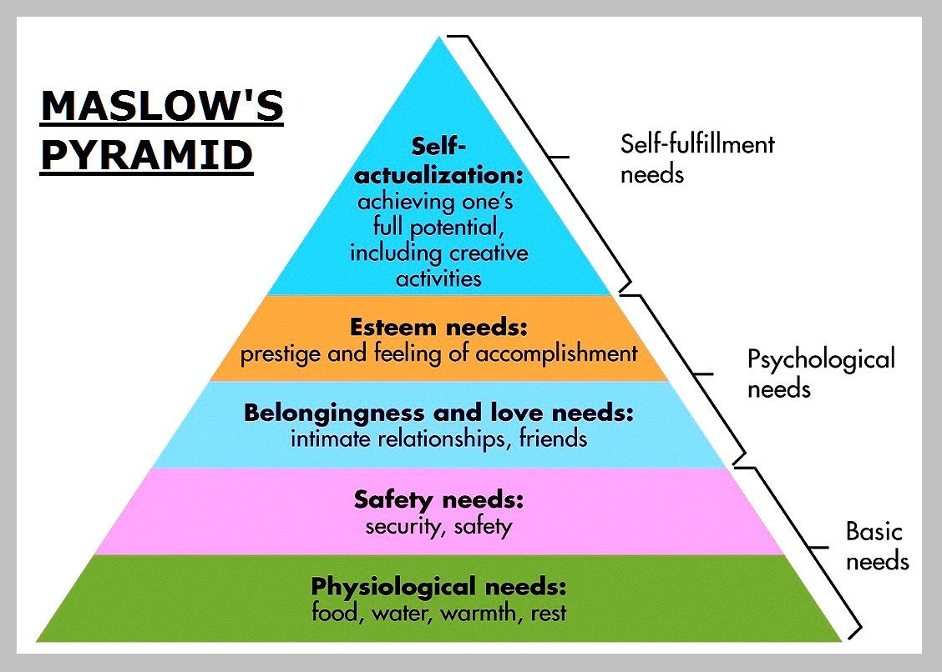
MARSLOW’S PYRAMID

Slide 30
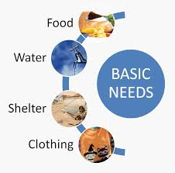
MARSLOW’S PYRAMID
1. Physiological Needs:
These needs are of the lowest-order and most basic needs of human beings. These involve satisfying fundamental biological drives, such as the need for food, air, water, cloth, and shelter. These needs exert tremendous influence on human behavior. Entrepreneur also being a human being has to meet his physiological needs for survival. Hence, he / she is motivated to work in the enterprise to have economic rewards to meet his / her basic needs.

Slide 31
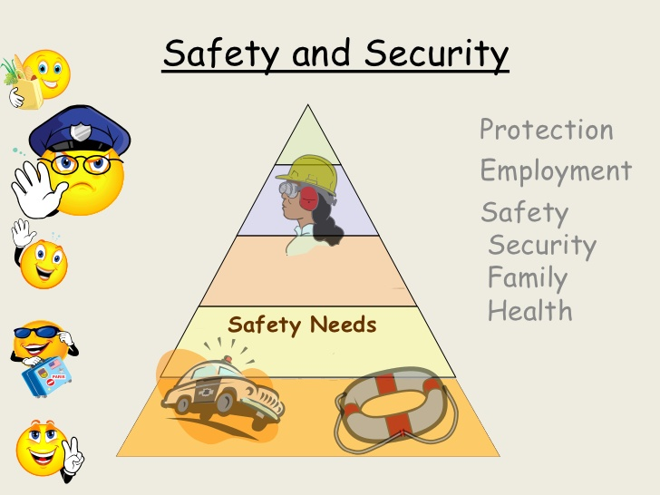
MARSLOW’S PYRAMID
2. Safety and Security Needs:
Once physiological needs are met. Safety needs involve the need for a secure environment, free from threats of physical and psychological harm. These needs find expression in such desires as economic security and protection from physical dangers. Meeting these needs requires more money and, hence, the entrepreneur is prompted to work more in his/ her entrepreneurial pursuit. Like physical needs, these become inactive once they are also satisfied.

Slide 32
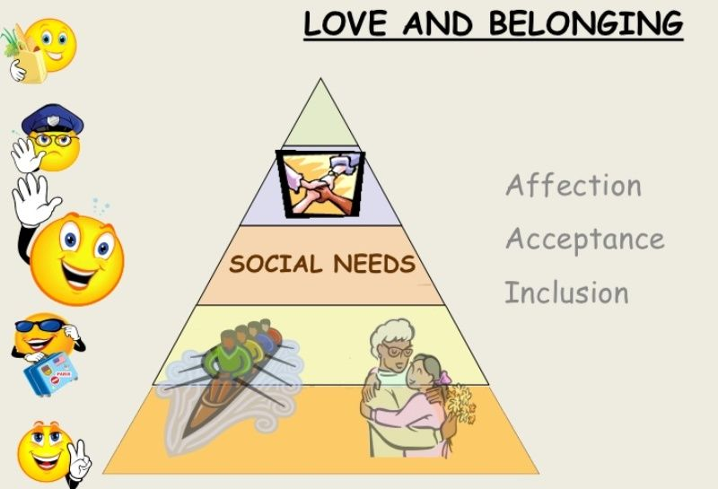
MARSLOW’S PYRAMID
3. Social Needs:
Man is social animal. These needs, therefore, refer to belongingness or affiliation. All individuals want to be recognized and accepted by others. Likewise, an entrepreneur is motivated to interact with fellow entrepreneurs, his employees, and others.

Slide 33
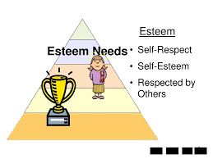
MARSLOW’S PYRAMID
4. Esteem Needs:
These needs refer to self-esteem and self-respect. These include such needs that indicate self-confidence, achievement, competence, knowledge, and independence. In case of entrepreneurs, the ownership and self- control over enterprise satisfies their esteem needs by providing them status, respect, reputation, and independence.

Slide 34


MARSLOW’S PYRAMID
5. Self-Actualization:
This refers to self- fulfillment. The term ‘self- actualization’ was coined by Kurt Goldstein and means to become actualized in what one is potentially good. An entrepreneur may achieve self-actualization in being a successful entrepreneur.
In Maslow’s need hierarchy theory, human needs are arranged in a lowest to the highest order. The second need does not dominate unless the first is reasonably satisfied and the third need does not dominate until the first two needs have been reasonably satisfied. This process goes on till the last need.
This is because man is never satisfied. If one need is satisfied, another need arises. Once a need is satisfied, it ceases to be a motivating factor.

Slide 35
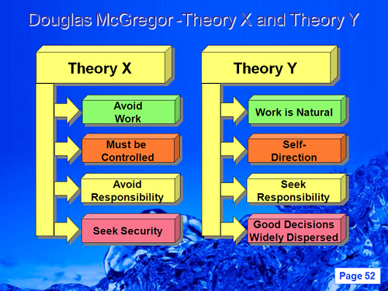
DOUGLAS McGREGOR THEORY X AND THEORY Y

Slide 36
DOUGLAS McGREGOR THEORY X AND THEORY Y
In 1960, Douglas McGregor formulated Theory X and Theory Y suggesting two aspects of human behaviour at work, or in other words, two different views of individuals (employees): one of which is negative, called as Theory X and the other is positive, so called as Theory Y.
Assumptions of Theory X
An average employee does not like work and tries to escape it whenever possible.
the employee does not want to work, he must be compelled, or warned with punishment so as to achieve organizational goals.
A close supervision is required on part of managers. The managers adopt a more dictatorial style.
Many employees rank job security on top, and they have little or no aspiration/ ambition.
Employees generally dislike responsibilities.
Employees resist change.
An average employee needs formal direction.

Slide 37
DOUGLAS McGREGOR THEORY X AND THEORY Y
Assumptions of Theory Y
Employees can perceive their job as relaxing and normal. They exercise their physical and mental efforts in an inherent manner in their jobs.
Employees may not require threat, but they can use self-direction and self-control if they are dedicated and sincere to achieve the organizational objectives.
If the job is rewarding and satisfying, then it will result in employees’ loyalty and commitment to organization.
An average employee can learn to admit and recognize the responsibility. In fact, he can even learn to obtain responsibility.
The employees have skills and capabilities. Their logical capabilities should be fully utilized. In other words, the creativity, resourcefulness and innovative potentiality of the employees can be utilized to solve organizational problems.
Thus, we can say that Theory X presents a pessimistic view of employees’ nature and behaviour at work, while Theory Y presents an optimistic view of the employees’ nature and behaviour at work.

Slide 38
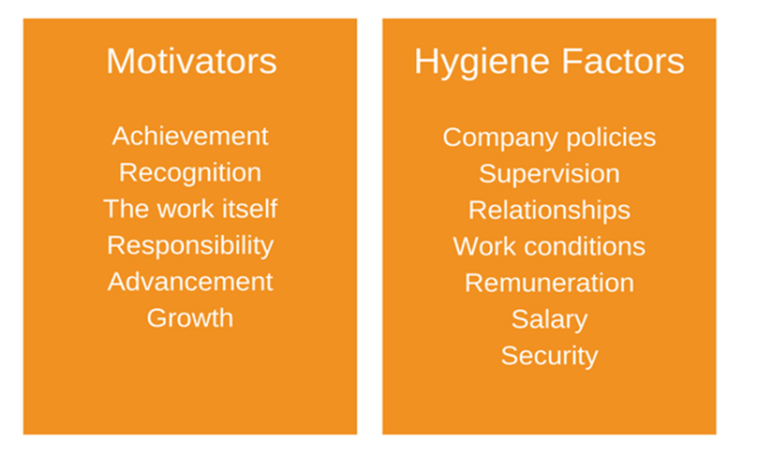
TWO FACTOR THEORY OF MOTIVATION

Slide 39
HERZBERG MOTIVATION HYGIENE THEORY
Model goes by a number of different names, including Two Factor Theory, Herzberg’s Motivation-Hygiene Theory, and Dual Structure Theory
Motivating factors include:
Achievement:
  Job must give an employee a sense of achievement.
  Provide proud feeling of having done something difficult but worthwhile.
Recognition:
  Job must provide an employee with praise and recognition of their successes
  Recognition should come from both their superiors and their peers
Work itself:
  Job itself must be interesting, varied, and provide enough of a challenge to keep employees motivated
Responsibility:
  Employees should “own” their work. They should hold themselves responsible for this completion
Advancement:
  Promotion opportunities should exist for the employee
Growth:
  Job should give employees the opportunity to learn new skills. Can happen either on the job or through more formal training.

Slide 40
HYGIENE FACTORS
Company policies:
Should be fair and clear to every employee.
Must also be equivalent to those of competitors
Supervision:
Supervision must be fair and appropriate.
Employee should be given as much autonomy as is reasonable
Relationships:
A healthy, amiable, and appropriate relationship should exist between peers, superiors, and subordinates
Work conditions:
Equipment and the working environment should be safe, fit for all purpose and hygienic
Salary:
Pay structure should be fair and reasonable
Should also be competitive with other organizations in the same industry
Status:
Should maintain the status of all employees within the organization
Performing meaningful work can provide a sense of status
Security:
Employees feel that their job is secure and they are not under the constant threat of being laid-off

Slide 41

JOB SATISFACTION
Job satisfaction refers to a person’s feeling of satisfaction on the job, which acts as a motivation to work
Not the self-satisfaction, happiness or self-contentment but the satisfaction on the job
Job satisfaction is defined as the, “pleasurable emotional state resulting from the appraisal of one’s job as achieving or facilitating the achievement of one’s job values”
Hoppock offered one of the earliest definitions of job satisfaction when he described the construct as being any number of psychological, physiological, and environmental circumstances which leads a person to express satisfaction with their job.
Smith et al. (1969) defined job satisfaction as the feeling an individual has about his or her job
Locke (1969) suggested that job satisfaction was a positive or pleasurable reaction resulting from the appraisal of one’s job, job achievement, or job experiences.

Slide 42

JOB SATISFACTION

Slide 43
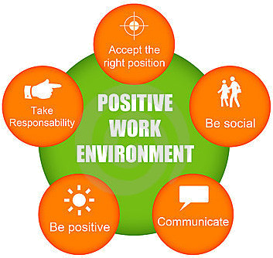
JOB SATISFACTION
Working Environment
Essential to provide employees with a work environment that is conducive to their overall development
Need an environment which is healthy and safe and which caters to both personal comforts and facilitates doing a good job
If the working conditions are good (clean, attractive surroundings), the personnel will find it easier to carry out their jobs
On the other hand, if the working conditions are poor (hot, noisy surroundings), personnel will find it more difficult to get things done

Slide 44

JOB SATISFACTION
Individuals who perceive that promotion decisions are made in a fair, are likely to experience satisfaction from their jobs
Very often employees are demotivated and dissatisfied with their jobs because unfair policies and practices prevail at their place of work.
Utmost importance for an organization to have a fair and equal system regarding practices and policies so that there is no discrimination and frustration.
Fair Policies And Practice

Slide 45
JOB SATISFACTION
Caring Organization
When people feel that the organization for which they are working, cares for them and takes actions to improve their work and lives, they are happy, and this creates higher satisfaction
Appreciation
Human race loves to be appreciated
Even for the smaller job that does one seek to have an appreciation, from colleagues, boss, and seniors
When one gets acknowledged in front of everyone, it gives up a boost to their morale
When appreciation leads to encouragement, the ultimate result is reflected in the efficiency of work automatically
Pay
Money not only helps people attain their basic needs but is also instrumental in providing upper-level need satisfaction
Employees often see pay as a reflection of how management views their contribution to the organization

Slide 46
JOB SATISFACTION
Age
Older employees tend to report higher satisfaction and younger employees say the lowest job satisfaction rates
Promotion
Promotions take some different forms and have a variety of accompanying rewards
Feel of Belongings
If an employee feels that he is considered an important part of the team, he belongs to the organization then there are higher chances of job satisfaction
Texting or emailing an employee on his/her birthday, communicating the crisis to even at the ground level employee, making special efforts during festive seasons, all these small little gestures make an employee believe that he or she belongs to the firm

Slide 47
JOB SATISFACTION
Initiation and Leadership
If an employee is given an equal number of opportunities to show their talent, take the lead and initiate then the chances of having a higher level of job satisfaction is more
Challenges
Few types of employees who love to experiment; they like it when the challenging job is assigned to them
To them, the challenge is always associated with ability and capability
Feel that if an employee is given a challenging job, it means that the leader trusts his or her capacity to fulfill the expectations
Responsibilities
Suggests that when an employee is given a bigger responsibility it makes him or her conscious about the fact that the employers think him or her as a capable and trustworthy candidate

Slide 48
JOB SATISFACTION
How Job Satisfaction Benefits the Company
Higher Job Satisfaction gives
Higher productivity
Less employee turnover
Reduce absenteeism
Reduces the level of unionization
Reduces the number of accidents
It helps to create a better working environment
Improving customer satisfaction
Faster and sustainable growth

Slide 49
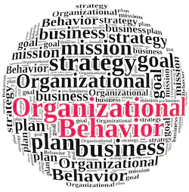

ORGANISATIONAL BEHAVIOUR
Organizational Behavior (OB) is related to individuals, group of people working together in teams. The study of organizational behavior relates to the expected behavior of an individual in the organization.
Researchers, management practitioners, psychologists, and social scientists must understand the very credentials of an individual, his background, social framework, educational update, impact of social groups and other situational factors on behavior.

Slide 50


ORGANISATIONAL BEHAVIOUR
Managers under whom an individual is working should be able to explain, predict, evaluate and modify human behavior that will largely depend upon knowledge, skill and experience of the manager in handling large group of people in diverse situations.
In words of K Aswathappa, “OB is the study of human behaviour in organizational setting, of the interface between human behaviour and organization.

Slide 51
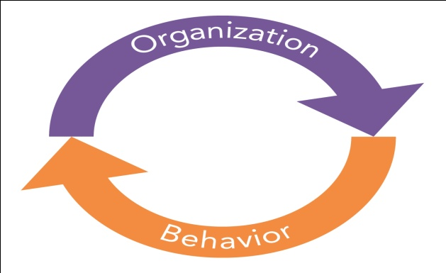
ORGANISATIONAL BEHAVIOUR
DEFINITION
“Organizational behaviour is directly concerned with the understanding, and control of human behaviour in organisations.”—Fred Luthans.
In words of Stephen P. Robbins, “OB is a field of study that investigates the impact that individuals, groups and structures have on behaviour within organisations for the purpose of applying such knowledge towards improving an organisation’s effectiveness.”

Slide 52
ORGANISATIONAL BEHAVIOUR
Multidisciplinary field that seeks knowledge of behavior in organizational settings by objective based on studying individual, group and organizational processes
According to L. M. Prasad, “Organizational behaviour can be defined as the study and application of knowledge about human behaviour related to other elements of an organisation such as structure, technology and social systems”
According to Davis and Newstram, “Organisational behaviour is the study and application of knowledge about how people act within organisations”

Slide 53


TWO FUNDAMENTAL COMPONENTS
Nature of the man
Nature of the organization
Organizational behavior may be organization of individual’s behavior in relation to physical means and resources so as to achieve the desired objective of the organization

Slide 54
NATURE OF ORGANISATIONAL BEHAVIOUR
Organizational behavior in the study of human behavior in the organizations
Whenever an individual joins an organization he
  Brings unique set of personal characteristics
  Experiences from other organizations
  Personal background
  Dynamics of how the incoming individuals interact with the broader organization
Individual who joins a new organization has to come into contact with the co-workers, managers, formal policies and procedures of the organization etc.

Slide 55
SCOPE OF ORGANISATIONAL BEHAVIOUR
OB provides a way for understanding human behavior in the organization for shaping human behavior
Direction for achieving certain predetermined objectives
Managers must know how the people in the organization behave
OB provides for understanding human behavior in all directions in which human being interact
OB can be understood at the
  Individual level
  Inter personal level
  Group level
  Inter group level

Slide 56

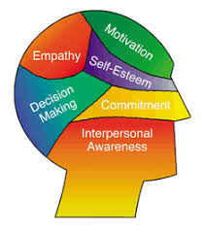
SCOPE OF ORGANISATIONAL BEHAVIOUR
1. Individual level: It analyzing why and how individual behaves in a particular way. OB integrates psychological, social, culture and other factors to provide simplicity in understanding human behavior.
2. Interpersonal Level: Interpersonal interaction is normally in paired relationship which represents man‘s most natural attempt at socialization. OB understands these interpersonal relationship in the organization. Analysis of reciprocal relationship, role analysis and transactional analysis are some of the common methods which provide such understanding.

Slide 57


SCOPE OF ORGANISATIONAL BEHAVIOUR
3. Group Level: Though people interpret anything at their individual level, they are often modified by group pressures, Research in group dynamics has contributed vitally to OB and shows how a group behaves in its norms, cohesion, goals, procedures, communication pattern, leadership and membership.
  4.Intergroup Level: The organization is made up of many group that develop a complex of relationships to build its process and substance. Inter group level relationship may be in the
  form of co-operation or competition. The co-operative relationship helps the organization in achieving its objectives.

Slide 58
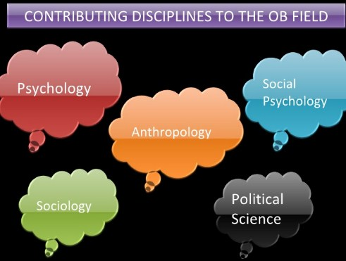
SCOPE OF ORGANISATIONAL BEHAVIOUR

Slide 59

PSYCHOLOGY
Understood as the science behavior
Concerned with individual behaviour
Greatly contributed to the intra-individual dynamics of human behaviour, in other words intra-personal aspects of OB like motivation, personality, perception, attitude, opinion, learning belief, feelings, ideas, emotions, training, needs, wish, decision making, job satisfaction

Slide 60

SOCIOLOGY
Psychology is the study of individual behaviour, and sociology is the study of group behaviour
Study of people in relation to fellow human beings. It focuses to understand group dynamics, formation of groups, communication, formal and informal organization and the likes

Slide 61

SOCIAL PSYCHOLOGY
Social psychology borrows concepts from both psychology and sociology
Focuses on the influence of people on one another
Focuses the understanding, changing attitudes and group decision-making process

Slide 62

ANTHROPOLOGY
Study of man and his work
Anthropologists study culture
Culture has significant influence on human behavior
Helps to analyze the differences in fundamental values, attitudes, and behavior between people in different regions and organizations

Slide 63
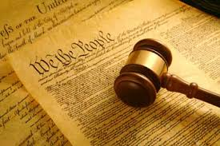
POLITICAL SCIENCE
A Study of the behaviors of individuals and groups within a political environment.
Political scientists study conflict, resolution, and group coalition, allocation of power and how people manipulate power for individual self-interest.

Slide 64

Organisational Behaviour
5 Key Elements:
People, Structure, Technology, Interactive Behaviour and Environment
Factor # 1. Individual
People are valuable resources of every organization. Individual is the most important component of OB. In fact, the study of OB revolves around individual, intrapersonal forces, study of interpersonal forces and study of an individual in an organizational setting.
Every individual differs from other, everyone behaves differently; however, those who behave same may be placed in one category and study can be made for each category so as to describe, understand, predict and control their behavior. The factors which affect the individual also affect OB.
For example, personality, attitude, learning, perception, values, ethics, norms, motivation, culture, thought process, family background, etc.

Slide 65

Organisational Behaviour
Factor # 2. Group:
An organization is a group of two or more persons, who collectively work for attainment of set objectives on a continuous basis. An individual behaves differently when he is in group, instead of that when he is alone. Even the behavior is different when he is in different groups e.g., when supervisor is accompanied with subordinates and when he is in company of other supervisors.
Under the study of OB, efforts are made to study behavior of people, when they are in a group. Therefore, group factors such as communication, group processes, group decision making, comparative values, cross cultural attitudes, etc., affect OB.

Slide 66

Organisational Behaviour
Factor # 3. Organizational Structure/Design
Organisational structure or design depends on division of work, departmentalisation, hierarchy and coordination. These factors vary in different organisations. Moreover, power relationships, extent of decentralisation, reporting methods and work procedures also differ in organisations.
These factors affect the individual and the OB. It becomes easier to get desired behaviour from employees when organisational design happens to be effective. If employees like the organisational structure, they are motivated and work happily in the organisation and vice-versa.

Slide 67

Organisational Behaviour
Factor # 4. Technology
The most important thing to achieve organizational goals is performance of assigned jobs by the employees. If the employees perform their jobs in time, then only organizational goals can be achieved. The work is performed with the help of technology i.e. with technique and equipment.
If the technology and equipment matches the choice of employees, they will be satisfied and tasks will be performed efficiently on time and vice versa. Thus, technology and equipment affect the employees’ behaviour as well as OB.

Slide 68

Organisational Behaviour
Factor # 5. Business Environment
The surroundings of a business in which it operates is called business environment. Business environment is composed of external and internal factors. External environment can also be classified as micro environment (which are controllable by firm and vary from industry to industry) and macro environment (which affects the whole economy).
Various environmental factors which affect organisation includes social, technological, political, economical and customers, suppliers, competitors, etc. Behaviour of employees is affected by these factors. Therefore, in OB, the effect of these factors on behaviour of people is also studied.

Slide 69
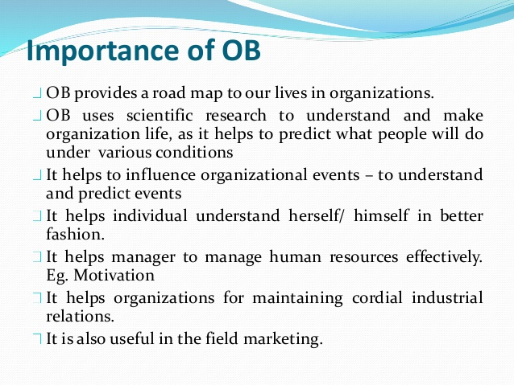
Organisational Behaviour

Slide 70
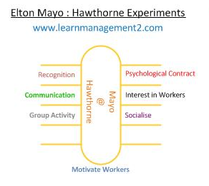
CASE STUDY
Elton Mayo: Hawthrone experiments.
Illumination Experiments,
Relay assemble test room Experiments,
Interview programme,
Bank wiring group observations

Slide 71

CASE STUDY
Elton Mayo’s team conducted a number of experiments involving six female workers. These experiments are often referred to as the Hawthorne experiments or Hawthorne studies as they took place at The Hawthorne Works of the Western Electric Company in Chicago.
Over the course of five years, Mayo’s team altered the female worker’s working conditions and monitored how the change in working conditions affected the workers morale and productivity. The changes in working conditions included changes in working hours, rest brakes, lighting, humidity, and temperature. The changes were explained to the workers prior to implementation.

Slide 72
CASE STUDY
At the end of the five year period, the female worker’s working conditions, reverted back to the conditions before the experiment began. Unexpectedly the workers morale and productivity rose to levels higher than before and during the experiments. The combination of results during and after the experiment (ie the increase in the workers productivity when they were returned to their original working conditions) led Mayo to conclude that workers were motivated by psychological conditions more than physical working condition

Slide 73
ILLUMINATION EXPERIMENTS
The main objective of the illumination experiments was to study the effect of the quality of lighting in the workroom on the efficiency of the workers. For this purpose the workers were divided into two groups. One group of workers was made to work in a room where lighting remained constant. The other group was made to work in a room where lighting was varied. The experiments revealed the production increased in both the rooms and therefore the quality of lighting had no impact on the efficiency level of the workers.

Slide 74
RELAY ASSEMBLY TEST ROOM EXPERIMENTS
These experiments were conducted in an assembly department where telephone relay units were assembled. The objective of the experiments was to ascertain the relationship between working conditions and productivity. Those employed in the department were all women and the work was repetitive one. A group of six women workers was made to take in a separate room. As they were doing their work a series of changes were introduced during the period of investigation. A new financial incentive plan was introduced to the group that assured additional remuneration for each worker depending on the collective performance of the group. The rest periods during week were also gradually increased. The workers were also permitted to leave an hour earlier. They were also given one full day holiday (on Saturdays). The study revealed that output of each individual and also that of the group increased due to the changes introduced.

Slide 75
THANK YOU

